Slide 1
Matplotlib & Seaborn
A picture is worth a thousand words

Slide 2
To cover
The next notebook demonstrations are on using matplotlib and seaborn
The first goal is to show you how matplotlib works so you can --
Create multiple graphs in a frame
Annotate and add vertical and horizontal bars
Save your graphs to a graphics file.
Read the documentation

Slide 3
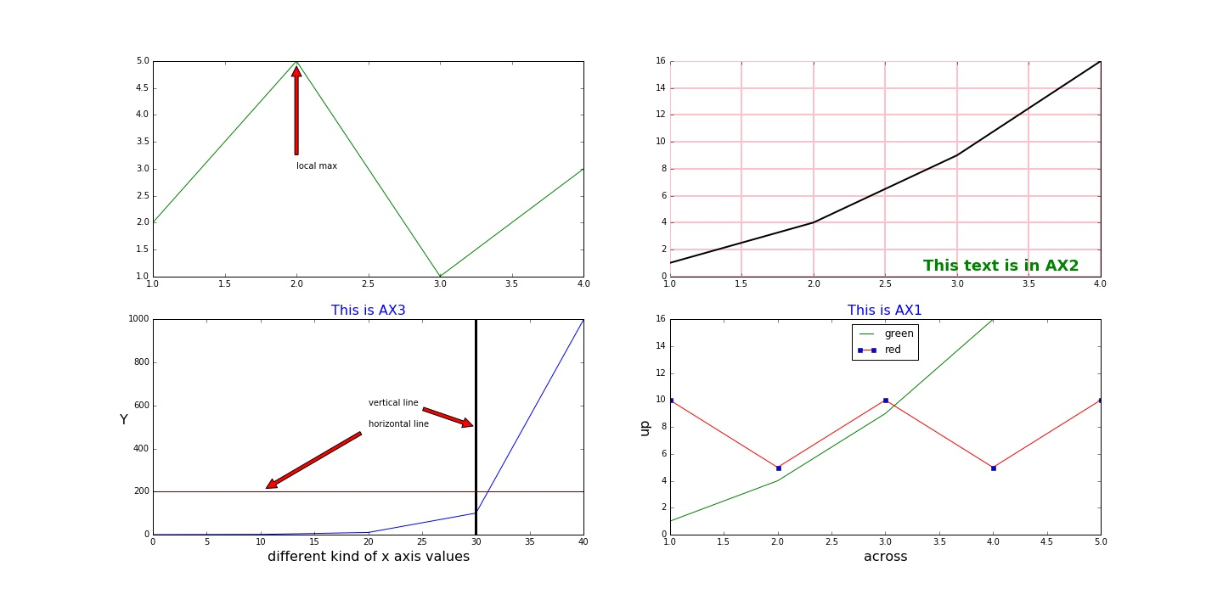
Simple graphs with Multiple features

Slide 4
Demonstration
Resizing graphs
Multiple graphs in one figure
Legends
Titles
Vertical and horizontal bars
Multiple plots
Grids and ticks

Slide 5
Opening a Graph Display
Method 1
Set up for a single plot --
fig = plt.figure( figsize=(20,10) )
ax = fig.add_subplot(111)
ax.set_title('This is the only one', fontsize=16, color='blue')
Set up for multiple plots --
fig = plt.figure( figsize=(20,10) )
fig.suptitle('demo graphics', fontsize=30, fontweight='bold', y=1.05)
ax1 = fig.add_subplot(224) # two rows, two columns, lower right
ax2 = fig.add_subplot(221) # two rows, two columns, upper left
ax1.set_title('This is AX1', fontsize=16, color='blue')
ax2.set_title('This is AX2', fontsize=16, color=’fuchsia')
plt.show()

Slide 6
Second Setup Method
Method 2
fig, axes = plt.subplots(nrows=3, ncols=4)
fig.set_figwidth(20)
fig.set_figheight(10)
plt.sca(axes[1, 1]) # 0,0 would be coordinates for upper left
plt.xticks(range(3), ['A', 'Big', 'Cat'], color='red',fontsize=14)
plt.sca(axes[1, 2]) # move to different plot
plt.xticks(range(3), ['A', 'B', 'C'], color='blue',fontsize=14)
plt.show()

Slide 7
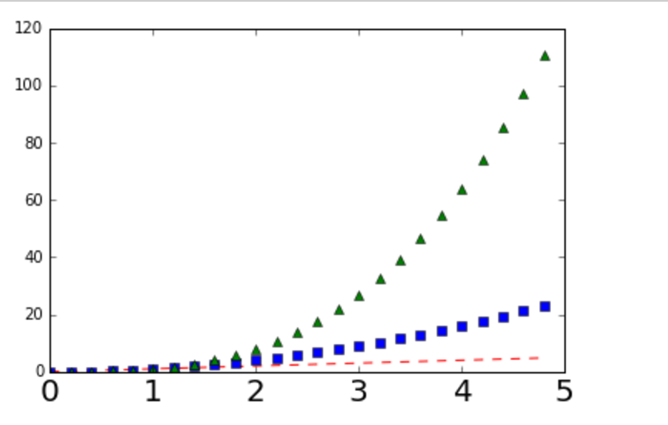
Demonstration 2 Matplotlib ‘Artists’
Line styles
Colors
Graph styles

Slide 8
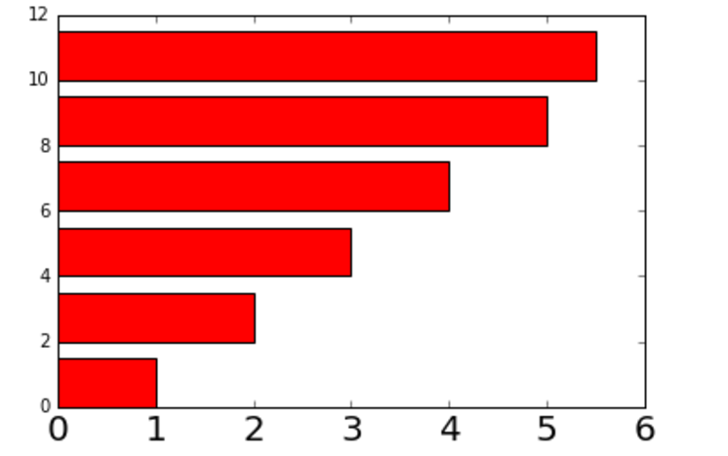
Demonstration 3
Bar chart
Histogram
Horizontal bar chart

Slide 9
Saving your image to disk
savefig(‘mygraph.png') , savefig(’mygraph.pdf')
This will give a rasterized or vectorized output respectively, both of which could be useful.
Pylab leaves a generous whitespace around the image. You can remove it with: savefig(’mygraph.png', bbox_inches='tight')
Thank you Stack Overflow

Slide 10
Practical Skills
Give me a fish and I eat for a day. Teach me to fish and I eat for the rest of my life.
Reading the documentation
http://matplotlib.org/1.4.3/api/pyplot_summary.html

Slide 11
A tour of Seaborn features
Visualization of statistical output
Regression plots
Scatter plots
Histograms and box plots
Categorical data and hue

Slide 12
Getting Wild
‘Plotting surfaces with matplotlib’
http://matplotlib.org/mpl_toolkits/mplot3d/tutorial.html

